Slide 1
Virtual Stick-Pad
Pooja Mishra (PSID : 28200)
Abinash Mishra (PSID : 28193)

Slide 2
Problem Statement
​With a demanding schedule, it’s natural to forget some important things such as meetings, task to do, responding back to an email or a call, project deadlines etc.

Slide 3
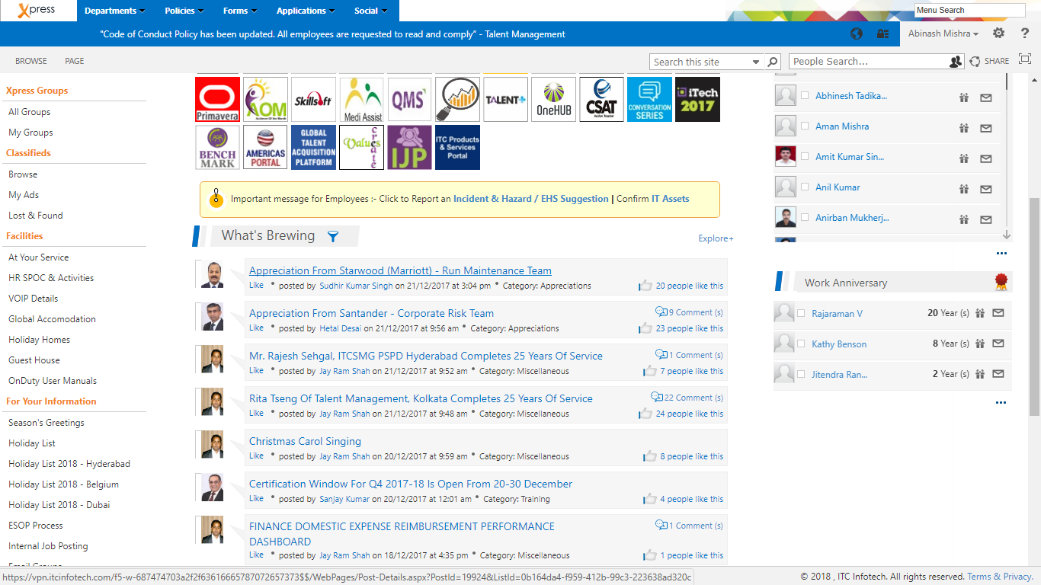
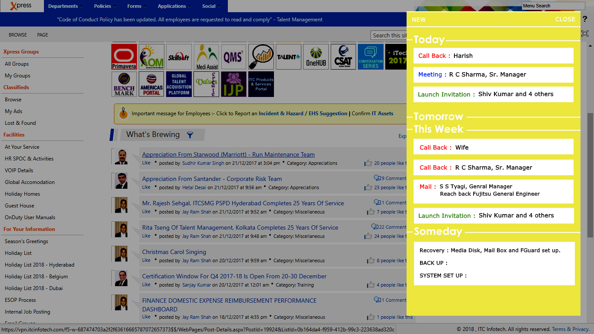

Slide 4
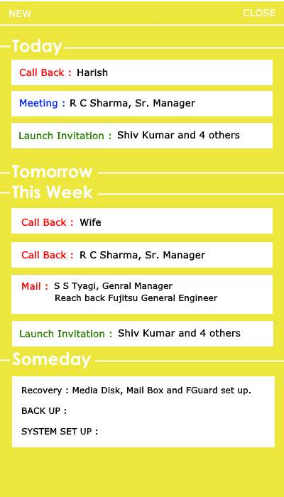
The Proposal
A digital dashboard of cards(stick notes) to visualize the agenda of the day, the next-day and the week.

Slide 5
Objectives
​To replace the traditional post-it notes which is less secure. (As in traditional stick notes, other people can read them and it can be misplaced at times but when we use online sticky notes we will be able to access that only after logging in)
​Allows the notes to be shared in groups and to individuals. (A manager can notify about an upcoming meeting to the team)
Saving memos and reminders for self-reference.
Collaboratively update.

Slide 6
Other Features
​​Shows the deadlines of the project an employee is working on. (On the note it shows "N days to go" and the counter keeps decreasing with each passing day)
Has the flexibility to personalize the way your notes look, depending on your preferences. It’s possible to adjust the background colour, image, transparency, font face, font colour and many more.

Slide 7
Further Challenges
Integrating the mail. (Saving an event from mail to the dashboard)
Priority based organizing cards.

